Slide 1
CEG 3110
Lesson 22
number
of lessons
taught on
metrics
2 –
|
10
|
20
number of lessons

Slide 2
Summary of Lesson 21
Software metrics tend to be either
process- or product-centric
In order for ordinary measures to be
transformed into useful metrics, they
may need to be:
  Combined with other measures in a meaningful way
  Analyzed in the context of long-term historical data
What does
this mean?
What does this mean?

Slide 3
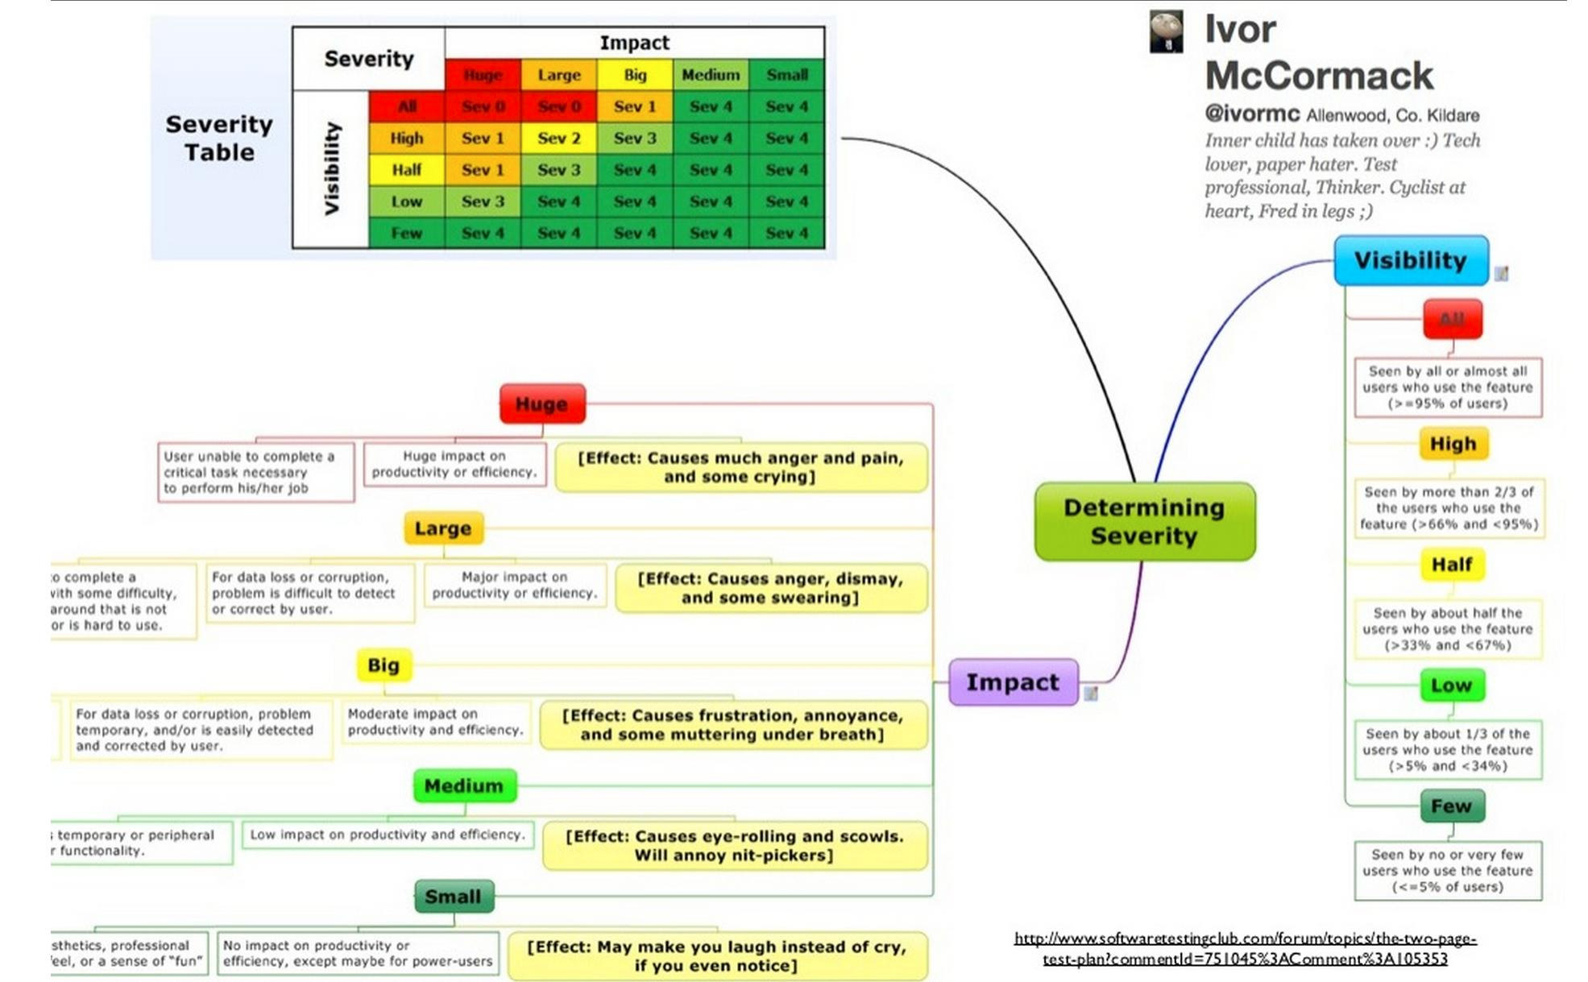
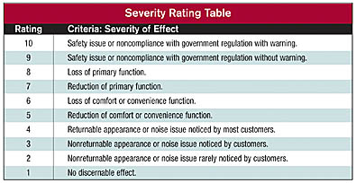
Categorizing Defects
Are all defects “created equal”?
How should we categorize them?
Is this a metric? How so?
Why is this important?

Slide 4
On Categorization http://softwaretestingfundamentals.com/defect/
Software Defects/ Bugs are normally classified as per:
Related Module / Component (Defect Location)
Severity / Impact (Defect Severity)
Probability of Visibility
Priority / Urgency (Defect Priority)
Phase Detected / Phase Injected
What is this?
Why is this important?
This same website says:
Software Testing proves that defects exist
but NOT that defects do not exist.

Slide 5
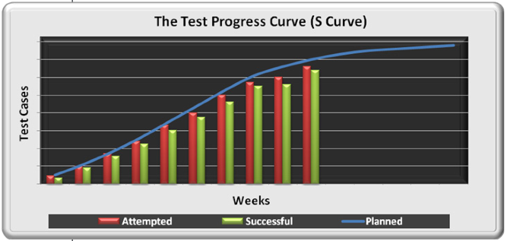

Passed
What information is depicted here?
Why is it shaped the way that it is?
What does it mean when things don’t look so good?
From the project planning
perspective, an S curve
forces better planning
How can we tell this was
developed by a project
manager, and not a tester?
For some weeks the test cases attempted
may be slightly ahead of plan, and the
successes slightly behind plan

Slide 6
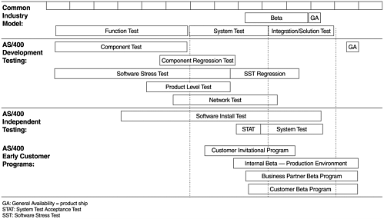
NOTE:
The number of test cases might
well run into the thousands, and
span across several testing phases.

Slide 7
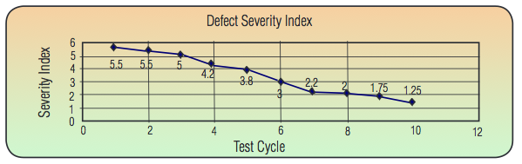
How about this graph?
What does it tell us?
Is this a good thing, or a bad thing?
Is this function always monotonically decreasing?

Slide 8
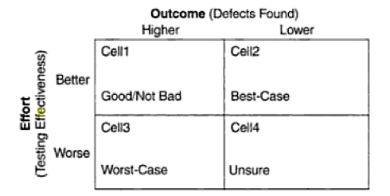
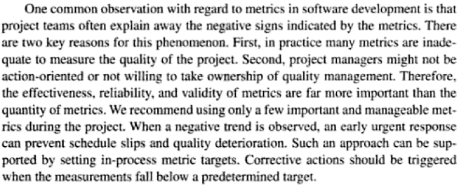
Quotes stop me if you don’t get these
Metrics can be classified into two groups:
those that measure the testing effectiveness (or testing effort),
and those that indicate the outcome of the test in terms of quality.
The two groups are called the effort indicators (e.g., test progress S curve),
and the outcome indicators (e.g., defect arrivals—total number and arrivals pattern)
(You
tell
me
why)
Metrics and Models in Software Quality Engineering
Stephen H. Kan

Slide 9
Another Interesting Metric:
Requirement Volatility
No. of reqs agreed upon vs no. of reqs changed
Let R = the no. of originally agreed upon system requirements
  Let R_{A} = number of original requirements deleted
  Let R_{D} = number of new requirements added
  Let R_{M} = number of requirements modified
RV = (R_{A} + R_{D} + R_{M}) / R
Example: VSS 1.3 release had total 67 requirements initially
Later:
  another 7 new requirements were added
  3 were removed from initial requirements
  11 requirements were modified
RV = (7 + 3 + 11) / 67 = 21 / 67 = 31.34%
  Almost 1/3 of the requirements changed after initial identification
Is this metric of interest to the tester?

Slide 10


Automated Testing Metrics
How much time does it take to run the test plan?
How much time does it take to do data analysis?
How long does it take to build a scenario/driver?
How often do we run the automated tests?
How many people do we require to run the tests?
How much system time/lab time is required to run the tests?
For each one, let’s discuss:
Is this useful?
Why or how is it useful?
What is this getting at?

Slide 11
Starting a metrics program...
WRONG!
Step 1: Determine what you want
to measure
Step 1: Determine your goals
Step 2: Build a “metrics architecture”
determine
WHAT
is happening
determine
WHY
it is happening
make a
DECISION
to fix what happening

Slide 12
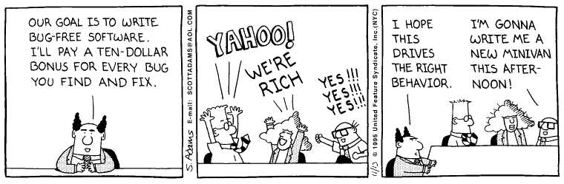
Metrics Select Process is Goal-Driven!
Knowing what you want to accomplish
determines what you want to measure
The cost of measuring is too high to
do it arbitrarily
Even then, a system can be misused
Failure Rate
of new metrics
programs?
A BIG
no-no!
Why?
CEG 463/663 Lessons 6 & 7

Slide 13
Using metrics to evaluate personnel
Failure Rate
of new metrics
programs?
A BIG
no-no!
Why?
CEG 463/663 Lessons 6 & 7

Slide 14
Back to These...
How much time does it take to run the test plan?
How much time does it take to do data analysis?
How long does it take to build a scenario/driver?
How often do we run the automated tests?
How many people do we require to run the tests?
How much system time/lab time is required to run the tests?
For each one, let’s discuss:
Is this useful?
Why or how is it useful?
What are we embracing?

Slide 15
A Cool Quote
“When you can measure what you are speaking about, and can express it in numbers, you know something about it; but when you cannot measure it, when you cannot express it in numbers, your knowledge is of a meager and unsatisfactory kind.”
(Lord Kelvin)

Slide 16
HW feedback
Single-sided printing?

Slide 17

White Box Exercise
println ("Enter number of digits for your number");
get (n);
if n >= 1 and n <=80 {
for i = 1 to n loop {
t := rand (0..7);
a[n] := t;
}
}
else println ("Error: Number of digits must be between 1 and 80”);
checking_for_leading_zeros := true;
for i = 1 to n loop {
if a[n] /= 0 then
checking_for_leading_zeros := false;
if not checking_for_leading_zeros
print (a[n]);
}
println ();
end

Slide 18
White Box Exercise
println ("Enter number of digits for your number");
get (n);
if n >= 1 and n <=80 {
for i = 1 to n loop {
t := rand (0..7);
a[n] := t;
}
checking_for_leading_zeros := true;
for i = 1 to n loop {
if a[n] /= 0 then
checking_for_leading_zeros := false;
if not checking_for_leading_zeros
print (a[n]);
}
println ();
}
else println ("Error: Number of digits must be between 1 and 80”);
end
R E M E M B E R
All branch nodes are depicted
by diamonds
All end statements are branches –
even if they look like this: }
Your graph might need a terminal
node

Slide 19
Traditional Blank Slide

